Slide 1
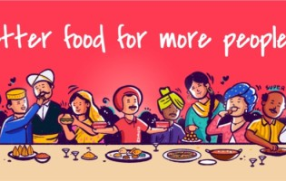
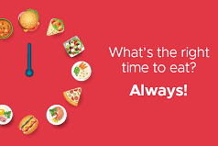


Zomato’s Market Penetration in USA

Slide 2

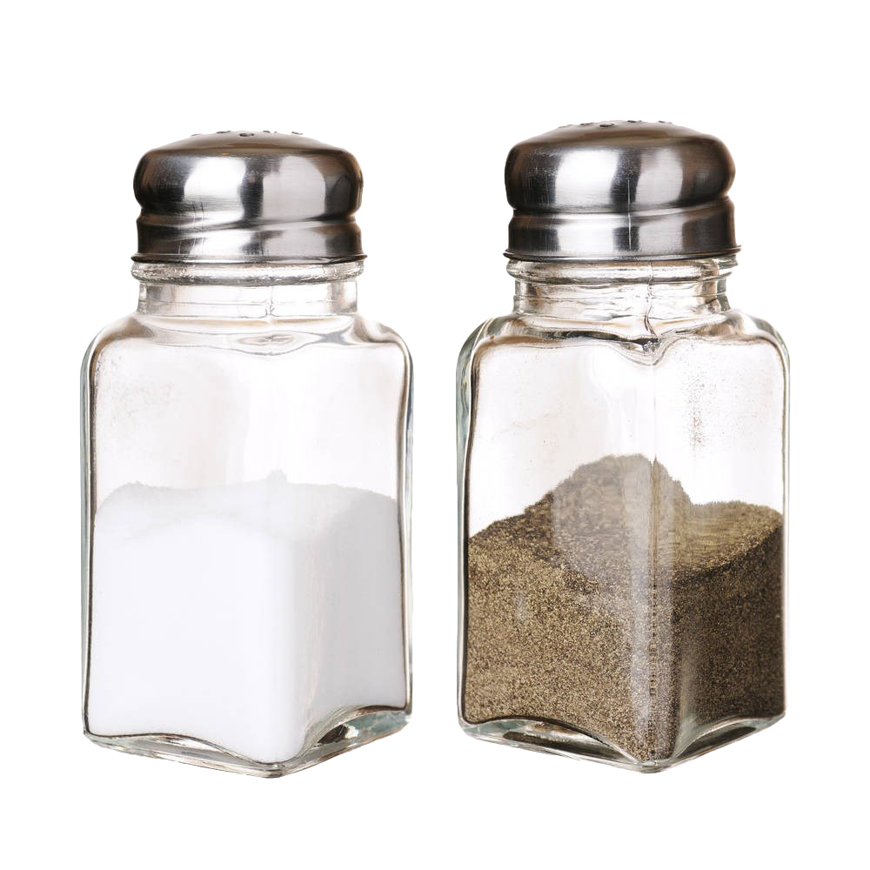

MEET THE TEAM (23692)
SUPRATIM ROY CHOWDHARY
AMIT MANOCHA
SIRI KADEMANI
HELEN KIM

Slide 3
agenda
Executive Summary
Project Background
Modeling Process
Data Acquisition
Data Preprocessing
Feature Extraction
Topic Modeling
Relevancy of Topics
Lessons Learned
Going Forward

Slide 4
Executive summary
Business Context
Why the US?
Problem Statement
Zomato, an online food delivery service in India is exploring the nuances of the US market in order to position itself against its main US-based competitors- DoorDash, Uber Eats, Grubhub.
US provides a great opportunity to enter a large and growing market and establish itself as a truly global brand. Also, it will help Zomato to diversify its main revenue stream from India and become a world leader in the food delivery space.
In order to understand the market dynamics on behalf of Zomato, we would be carrying out an analysis based on the data collected from Reddit to better understand the strengths and weaknesses of food delivery apps in the US market.
Data Modeling
Topic Modeling Results
Managerial Insight
Data acquired from Reddit for three main competitors was pre-processed using Spacy, followed by feature extraction. Then, the LDA model was used to identify key areas.
Focusing on the top 3 topics identified will help Zomato take a lead over its competitors and position itself effectively in the US market.
Streamlining of the ordering and delivery process, positive customer interactions with drivers and appropriate grievance redressals can help Zomato to establish it in the market and enable it to become a profitable venture.
Notes:
First we have written up an executive summary to give a quick overview of our project.
We will be looking into Zomato, an indian food delivery service, and its opportunity to expand its business to the US.
Although Zomato is currently available in 24 countries, US is not yet a part of its market and based on research we identified the US's market size and consumer trend as an opportunity for Zomato to expand. In order to understand the market dynamics on behalf of Zomato, we carried out an analysis based on Reddit data on competitors such as Doordash, uber eats, and grubhub to understand the strenghts and weaknesses of food delivery platforms in the US market.
WIth this data we ran the LDA model to identify 3 prominent topics that provided insight on which aspects Zomato should focus when launching in the US.

Slide 5




Background
Zomato is an Indian online application that allows users to search for and discover restaurants, cafes, and other food-related businesses. Users can search for a specific type of cuisine or dish, browse menus, read reviews and ratings from other users, and place orders for delivery or pickup. In addition, Zomato offers various features for restaurant owners, such as online ordering systems and marketing tools to help them grow their business. Overall, Zomato is a one-stop-shop for all things food-related, connecting users with great dining experiences and helping restaurants reach a wider audience.
2010
Unit: millions (as of Sep. 2021)
Notes:
So first, what is Zomato?
Zomato is an indian online application found in 2010 that allows users to search for restaurant and cafes. Furthermore, users can order and pay on the app as well, making it a one-stop-shop for all things food-related. As of September 2021, the number of followers Zomato has on Instagram, Facebook and Twitter are greater than those for Doordash and Grubhub, suggesting that it is a business worthy of competition.

Slide 6
Reasons for Zomato to enter the US market
1
Large Market Potential
The US has a population of approx. 332 mil., a GDP of $22.67 trillion, and a disposable income per capita of $47,743.
2
Zomato currently successfully operates in 24 countries, and over 10,000 cities.
Diversification
Enhance Zomato’s reputation as a global brand
Opportunity to tap into a large market potential and increasing demand for food delivery in the US
Proven track record that can be leveraged to compete
Diversify revenue streams and reduce dependence on the Indian market
3
Market share of Doordash: 57% / Uber Eats: 25% / Grubhub:12% in the US.
Competition
4
International Recognition
Zomato has a MAU of 70 million and is a publicly traded company with a market capitalization of $12.6 billion.
5
Increasing Demand for Food Delivery
Online food delivery market in the US is expected to reach $32.7 billion, and the COVID-19 pandemic has led to a significant increase.
Sources: Statistica, 2021 / Second Measure, 2021 / Zomato, 2021 / Yahoo Finance, 2021
Notes:
Helen has already given a brief on Zomato’s background. I’ll go through the main reasons why Zomato is considering the US market.
US has a huge market potential,: with a population of around 332 mil and a GDP of 22.67 Trillion.
Zomato is already operating in few major countries and knows how to deal with diverse population.
Then there is competition and
International Recognition, also there is a huge
Increase in Demand for food delivery, ever since Covid-19 pandemic

Slide 7



Problem statement
For Zomato to enter the US market, it needs to understand the salient features of its competitors to determine how it can position itself in the US market.
As a marketing firm, we will be conducting an analysis on social media platforms like Reddit to explore the competitors’ strengths.
Customer services
Delivery time
Promotional offers
Price
Popular food choices
Application functionality
The user interface of the app.
Notes:
For Zomato to enter the US market, it needs to understand the key features of its competitors to determine how it can position itself in the US market.
As a marketing firm, we will be conducting an analysis on social media platforms like Reddit to explore the competitors’ strengths and weaknesses.

Slide 8




Modeling process flow
Data Acquisition
Data Pre-Processing
Feature Extraction
Topic Modeling
Collected comments from Doordash, Uber Eats, and Grubhub SubReddits using praw.
Removed duplicates, stop words, punctuation, conversion into lower case
Performed count vectorization to determine term frequency and created Word Clouds
Built LDA model to fetch top 5 topics relevant to the project
Notes:
So, how did we go through this process,
We started off by collecting data from Doordash, UberEars, and Grubhub subreddits using Praw.
Then did some pre-processing (lemmatized, Removed duplicates, stop words, punctuation, conversion into lower case)
For feature extraction, we used bag of words
And later used LDA to fetch top 5 relevant topics

Slide 9
Data acquisition
Subreddit Name | Why collecting it? | # of subscribed users (as of 1/29/2023) | # of data collected
 | To understand customer/employee reviews/opinions on dominant food delivery service platforms in the USA. | 199k | 3238
 | To understand the customer's opinions and their reviews on the services provided by UberEats. Further, analyze the issues faced by customers in the food delivery segment. | 85.2k | 3301
 | To understand key issues and opinions regarding Grub Hub. | 4.4k | 3407
Notes:
Data Acquisition:
To understand customer reviews on food delivery service platforms Doordash, UberEars, and Grubhub we collected data from subreddits.
We collected around 10k reviews for our analysis across platforms.

Slide 10
Data acquisition issues
The data collected was not of very high quality and had a lot of noise, here’s why:
• The content present in this data was very vague and did not cover everything needed for the project.
• Few of the data in Subreddit wrt to companies were not very relevant.
• Some comments from the data collected only represent delivery/service aspect of the platforms. (Ex: DoorDash employees complaining on subreddit about not getting enough tip).
Steps taken,
Filtered out irrelevant data: We did set up a few criteria to identify relevant data and removed the irrelevant data from the dataset.
Explored various subreddits: There were a few subreddit highly biased towards employees rather than customer experience, we had to find the subreddits most relevant to our scope.
Notes:
We did face some issues while collecting the data like,
• The content present in this data was very vague and did not cover everything needed for the project.
• Few of the data in Subreddit wrt to companies were not very relevant.
• Some comments from the data collected only represent delivery/service aspect of the platforms, instead of customer experience (Ex: DoorDash employees complaining on subreddit about not getting enough tip).
To tackle with these issues,
Filtered out irrelevant data: We did set up a few criteria to identify and removed the irrelevant data from the dataset.
Explored various subreddits: There were a few subreddit highly biased towards employees rather than customer experience, we had to find the subreddits most relevant to our scope.

Slide 11
Data preprocessing
Duplicate removal
Stop word removal
Lemmatization
Eliminate punctuation / white spaces
Conversion into lower case
Normalization
Notes:
For preprocessing we used spacy and did some normalization on the text.
We started off by removing the duplication and moving on to stop words removal, lemmatizing, removing punctuations, and conversion to lower case.
Now Supratim will talk more about the feature extraction.

Slide 12
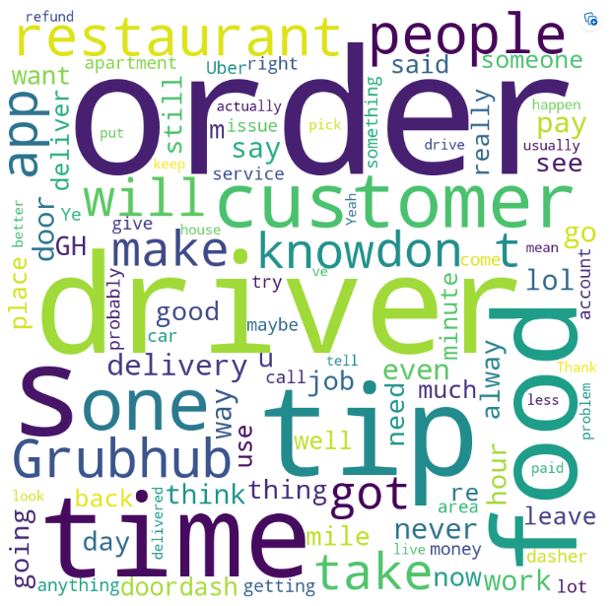
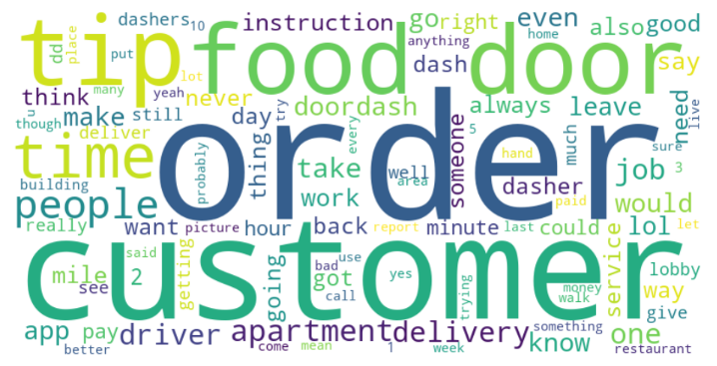
Feature extraction- word clouds
Word Cloud for all comments (Door Dash, Uber Eats, Grub hub)
Word Cloud for comments from Door Dash Subreddits

Slide 13
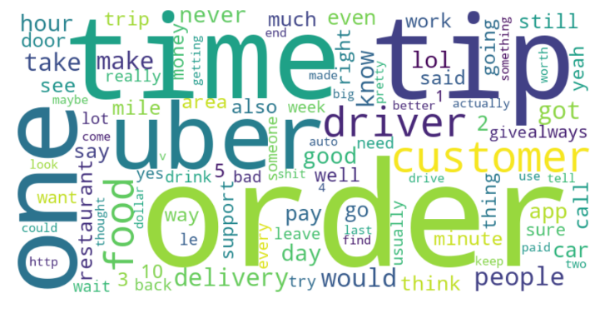
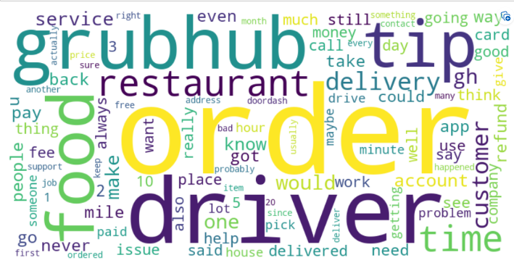
Feature extraction- word clouds
Word Cloud for comments from Uber Eats Subreddits
Word Cloud for comments from Grubhub Subreddits

Slide 14
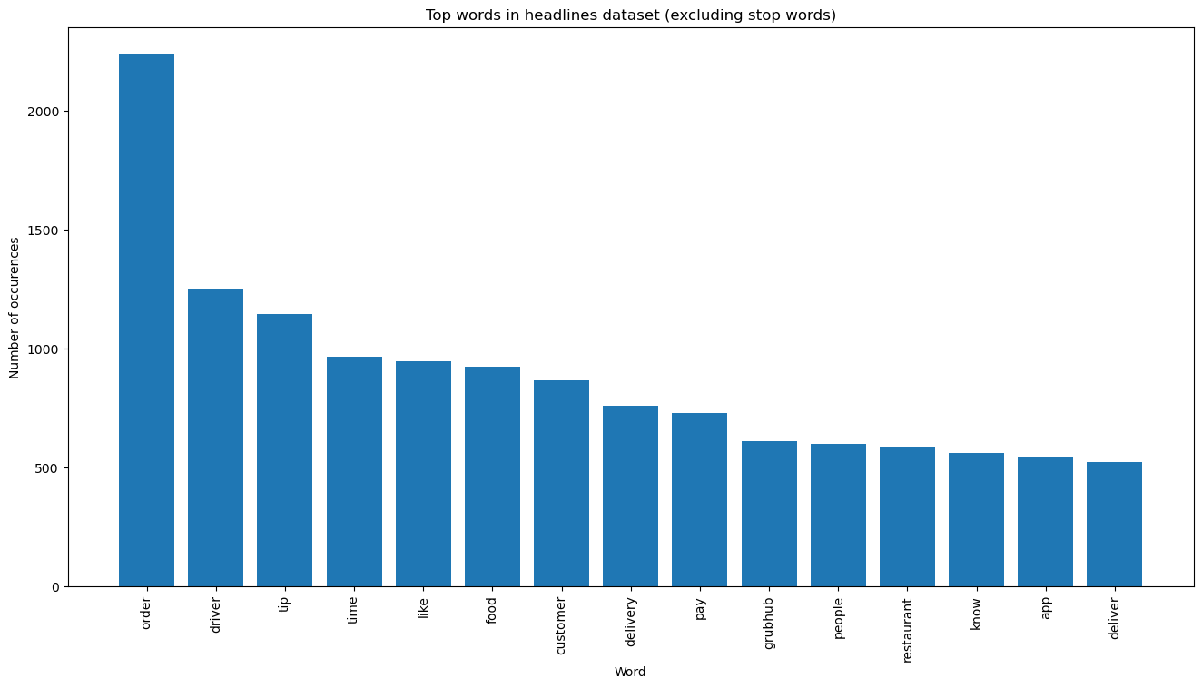
Feature extraction- top 15 words
Below are the top 15 frequent words from all comments

Slide 15
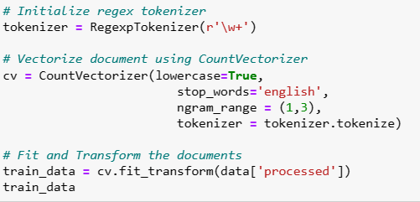
Count vectorization
The idea behind this is that the frequency of each term in a document provides valuable information about the topics discussed in that document.
For example, a document that contains a high frequency of terms related to “Food-Delivery” is likely to be about food delivery topics. This is used to fetch high frequency words in the corpus.

Slide 16
Model selection
Why the Latent Dirichlet Allocation (LDA) model for our problem?
Analyze co-occurrence of words to identify groups of words that appear together frequently
→ TOPICS
Estimate the distribution of topics in each document, and the distribution of terms in each topic
LDA can help Zomato analyze customer reviews of competitors in the US market. By identifying the topics most associated with competitors, insight into areas of opportunity and potential advantages can be obtained.
Notes:
Why LDA (Latent Dirichlet Allocation) for our problem?
LDA can help identify the topics and words that are most associated with positive or negative sentiment in customer reviews. By analyzing the co-occurrence of words across documents, LDA can identify groups of words that tend to appear together frequently, which can be interpreted as topics.
Once these topics have been identified, LDA can then estimate the distribution of topics in each document and the distribution of terms in each topic. This information can be used to determine which topics and words are most associated with positive or negative sentiment, which can then be used to inform product development, marketing, and other business decisions.
A company like Zomato could use LDA to analyze customer reviews of competing food delivery services in the US market. By identifying the topics and words that are most associated with positive or negative sentiment, Zomato could gain insights into areas of opportunity and potential competitive advantages in the US market. This information could then be used to inform the company's product strategy and marketing efforts.

Slide 17
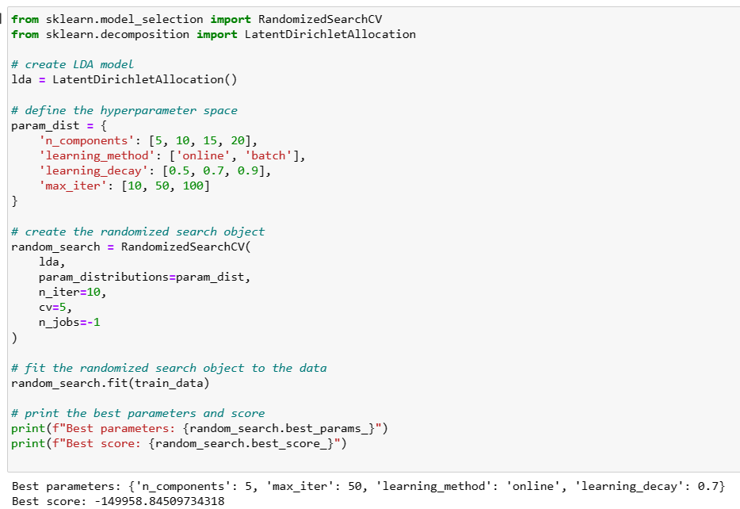
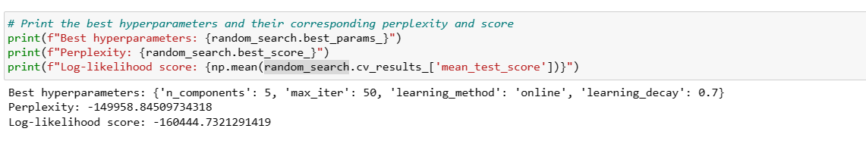
PARAMETERS FOR THE BEST PERFORMING MODEL
Scores based on manual setting of hyperparameters: Perplexity: 1692.1846294932805 Log-likelihood: -639839.9380307496
Scores after performing Randomized CV search: Perplexity: -149958.84509734318 Log-likelihood score: -160444.7321291419
The scores after randomized CV search indicate that the model is performing relatively well in terms of topic modeling.
Notes:
As a lower perplexity score and a higher log-likelihood score indicate better performance, the scores after randomized CV search indicate that the model is performing relatively well in terms of topic modeling.

Slide 18
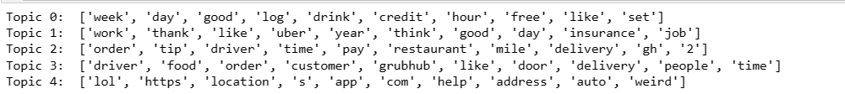
Fetching 5 Topics along with Top 10 terms
Fetching the top 10 terms for each topic identified by LDA gives us a glimpse of the most significant words for each topic and allows us to interpret the meaning of each topic based on these words.
The number of topics have been selected after performing randomized search.
Top 5 Topics:

Slide 19
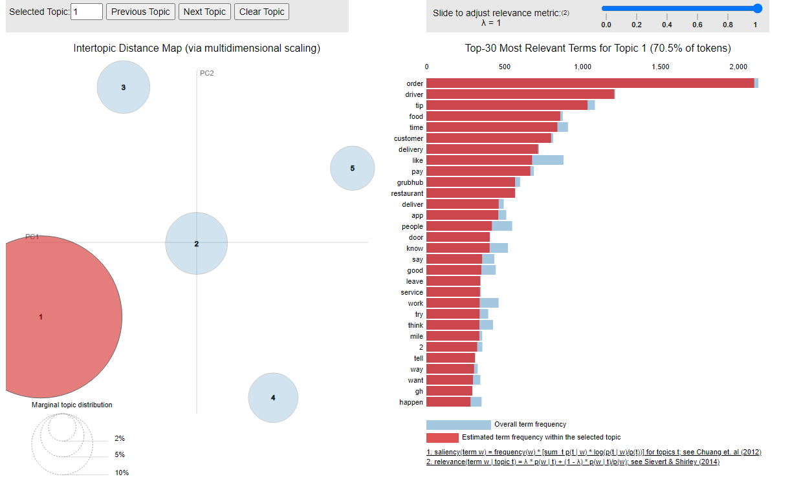
Topic 1 – Time, personal, and finance expressions
Frequent Words_Topic 1
1 | Week | 9 | Hour
2 | Day | 10 | Free
3 | Good | 11 | Restaurant
4 | Log | 12 | Deliver
5 | Drink | 13 | Order
6 | Credit | 14 | Driver
7 | Like | 15 | Tip
8 | Set
This topic includes keywords such as “week”, “day”, “good”, “log”, “drink”, “credit”, “like”, “set”, “hour,” “free”, suggesting that this topic is related to the Time, personal and finance expressions. This topic may cover features such as delivery timeframes and scheduling, customer ratings and reviews, account management and tracking, menu categories, payment options, order customization, and promotions and discounts.
Notes:
If we consider Zomato's entry into the US market, this topic could be particularly relevant for the company. Zomato is a food delivery app that allows customers to order food from restaurants in their local area. The features mentioned in this topic, such as delivery timeframes and scheduling, account management and tracking, and promotions and discounts, are all important aspects of a food delivery app that could help Zomato attract and retain customers in the competitive US market.
Additionally, personal finance expressions such as "credit" and "free" could be relevant to Zomato's business model. For example, Zomato could offer promotions or discounts to customers who use certain credit cards or payment methods. By leveraging these features and optimizing its app to meet the needs of US customers, Zomato could differentiate itself from competitors and gain a foothold in the market.

Slide 20
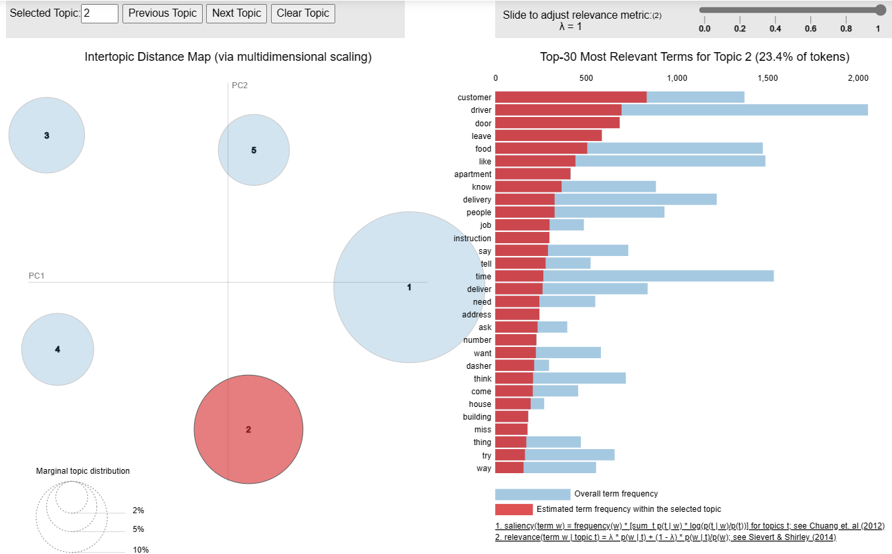
Topic 2 – Order and Delivery Process
Frequent Words_Topic 2
1 | customer | 9 | delivery
2 | driver | 10 | people
3 | door | 11 | job
4 | leave | 12 | instruction
5 | food | 13 | say
6 | like | 14 | tell
7 | apartment | 15 | time
8 | know
This topic includes keywords such as “order,” “tip,” “driver,” “time,” “pay,” “restaurant” “mile,” and “delivery”, suggesting that this topic is related to the order and delivery process. This topic may cover features such as order tracking, estimated delivery time, payment options, tipping options, and restaurant selection.

Slide 21
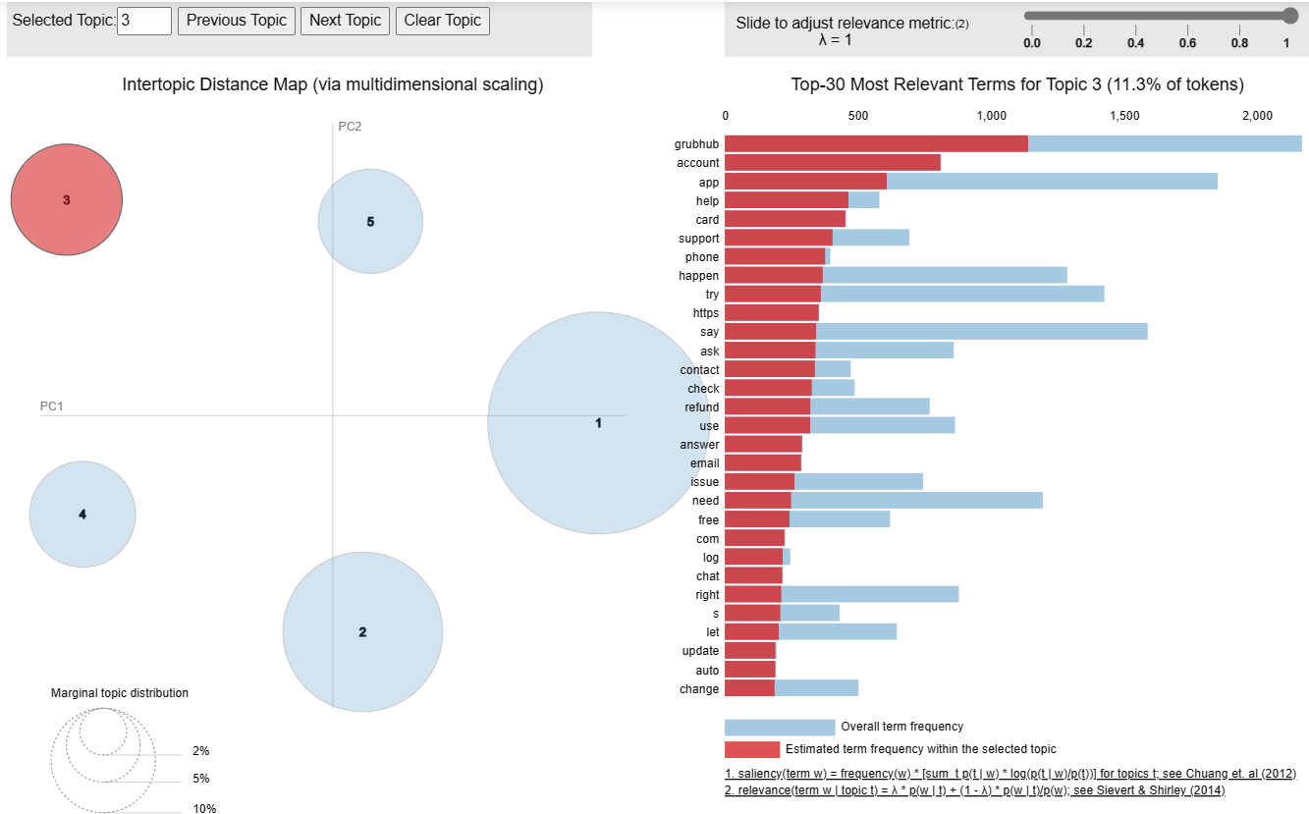
Topic 3 – Customer and Driver Interactions
Frequent Words_Topic 3
1 | grub hub | 9 | try
2 | account | 10 | https
3 | app | 11 | say
4 | help | 12 | ask
5 | card | 13 | contact
6 | support | 14 | check
7 | phone | 15 | refund
8 | happen
This topic includes keywords such as “driver,” “food,” “order,” “customer,” “grubhub,” “door,” “delivery,” and “people”, suggesting that this topic is related to the interactions between the customer and the driver during the delivery process. This topic may cover features such as communication between the customer and driver, delivery instructions, and feedback and rating systems.

Slide 22
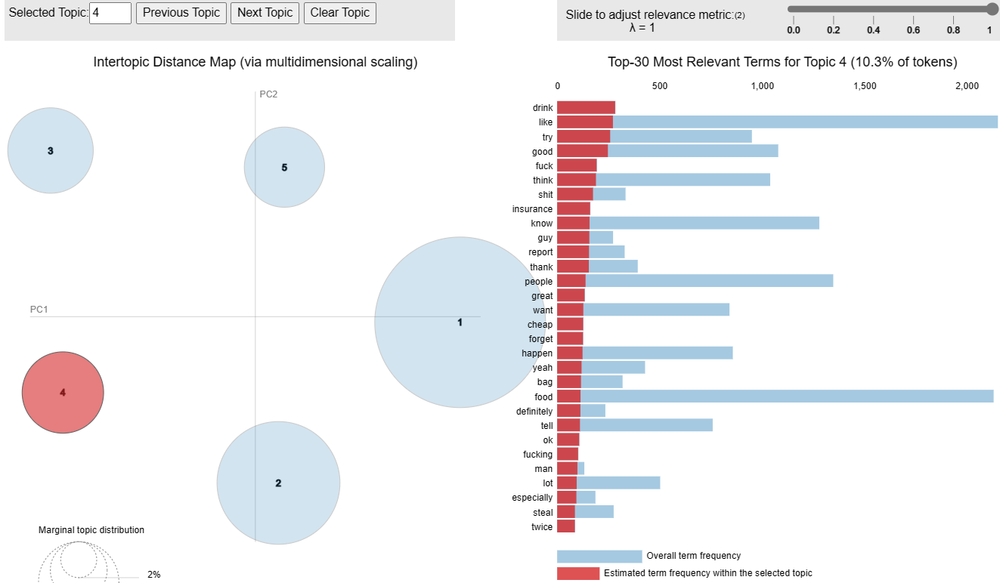
Topic 4 – App Support and Assistance
Frequent Words_Topic 4
1 | Drink | 9 | Report
2 | Like | 10 | Thank
3 | Try | 11 | People
4 | Good | 12 | Great
5 | Think | 13 | Want
6 | Insurance | 14 | Cheap
7 | Know | 15 | Forget
8 | Guy
This topic includes keywords such as “help,” “location,” “app,” “address,” and “weird”, suggesting that this topic is related to the support and assistance features. This topic may cover features such as customer support, help center, app settings and preferences, and location-based services.

Slide 23
Topic 5 – Technical issues with online platforms and services
Frequent Words_Topic 5
1 | https | 9 | Preview
2 | nice | 10 | width
3 | help | 11 | Grub hub
4 | com | 12 | reach
5 | auto | 13 | contact
6 | log | 14 | insurance
7 | format | 15 | www
8 | enabled
This topic includes keywords such as “lol”, “https”, “location”, “s”, “app”, “com”, “help”, “address”, “auto”, “weird”, suggesting that this topic is related to the technical issues with online platform and services. For instance, the words' 'location' and 'address' suggest that the app includes geolocation technology and a delivery process, respectively. Additionally, the word 'help' indicates that the app provides customer support, while the term 'https' suggests that the app takes users' privacy and security seriously. The word 'auto' may indicate an automatic address recognition or suggestion feature, whereas 'weird' could refer to an unexpected or unusual aspect of the app.

Slide 24



Relevancy of topics
Topic 1: Order & Delivery Process
Topic 2: Customer & Driver Interactions
Topic 3: App Support & Assistance
The food delivery market in the USA is highly competitive, and customers expect features such as order tracking, payment options, tipping options, and restaurant selection. Therefore, food delivery apps need to offer a seamless order and delivery process to meet customer expectations and maintain a strong customer base.
Critical features of a food delivery app such as order tracking, communication, and feedback systems are essential to providing a seamless customer experience and maintaining a strong customer base in a highly competitive market.
Features such as customer support, help center, app settings and preferences, and location-based services are essential to providing a seamless and user-friendly experience. These features not only help customers troubleshoot any issues they may encounter but also improve their overall experience with the app, increasing the likelihood of repeat business.
Notes:
Topic 1:
If we consider Zomato's entry into the US market, this topic could be particularly relevant for the company. Zomato is a food delivery app that allows customers to order food from restaurants in their local area. The features mentioned in this topic, such as delivery timeframes and scheduling, account management and tracking, and promotions and discounts, are all important aspects of a food delivery app that could help Zomato attract and retain customers in the competitive US market.
Additionally, personal finance expressions such as "credit" and "free" could be relevant to Zomato's business model. For example, Zomato could offer promotions or discounts to customers who use certain credit cards or payment methods. By leveraging these features and optimizing its app to meet the needs of US customers, Zomato could differentiate itself from competitors and gain a foothold in the market.
Topic2:
Zomato could differentiate itself from competitors by providing innovative features in this area.
For example, Zomato could provide real-time tracking of the driver's location, estimated time of arrival, and even the option to communicate with the driver. Zomato could also provide various payment options, such as paying through the app, using cash, or offering a tipping option.
Additionally, Zomato could collaborate with restaurants to optimize their delivery process and ensure that orders are delivered on time and in good condition. By focusing on this topic and providing a seamless order and delivery experience, Zomato could establish itself as a reliable and efficient food delivery app in the US market.

Slide 25

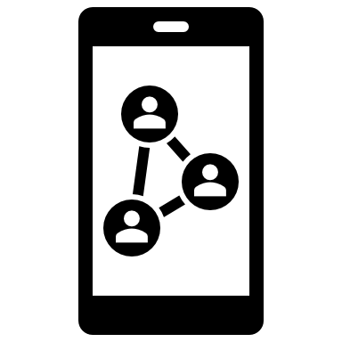




Relevancy of topics
Topic 5: Technical issues with online platforms and services
Topic 4: Time, Personal & Finance Expressions
This is relevant to food delivery apps in the USA as it highlights some of the common features and functionalities that users may expect from a food delivery app. The use of geolocation technology, secure website protocols, customer support, and automatic address recognition can all help to enhance the user experience and make the app more competitive in the crowded food delivery market in the USA. By providing these features and ensuring user privacy and security, food delivery apps can attract and retain users, which is crucial for success in the highly competitive market.
Users can choose the day and time for their delivery, track their order status in real-time, rate and review their orders, and receive promotions and discounts on their orders.
These features have become increasingly important in the competitive food delivery market in the USA, where many companies are competing for users' attention and loyalty.
.

Slide 26
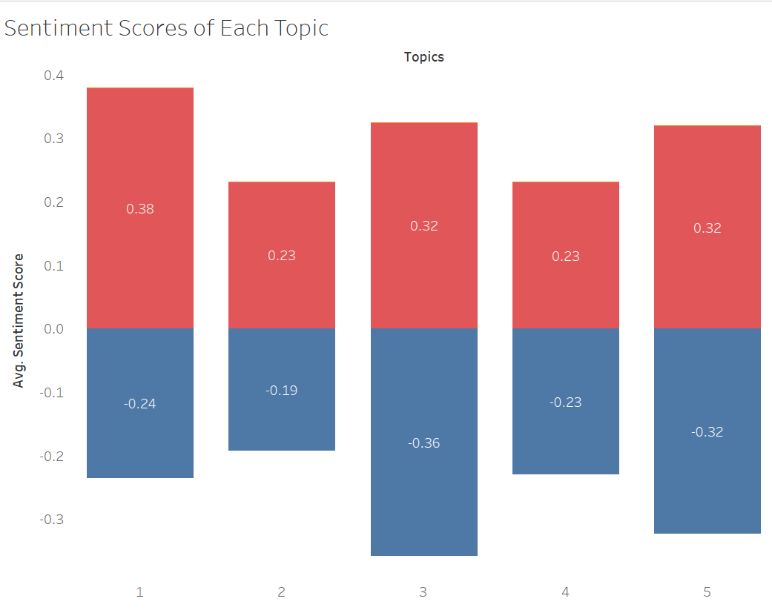
Sentiment analysis on topics
Topic 1 – Time, personal, and finance expressions
Topic 2 – Order and Delivery Process
Topic 3 – Customer and Driver Interactions
Topic 4 – App Support and Assistance
Topic 5 – Technical issues with online platforms and services
Based on the graph, we observe that Topic 3 has the highest negative sentiment score of around -0.36 while Topic 1 has the highest positive sentiment score of 0.38.
Hence, we can focus on the strengths of Topic 1, Topic 2 and Topic 3 more and try to prevent the weaknesses of Topic 3 and 5.
.

Slide 27
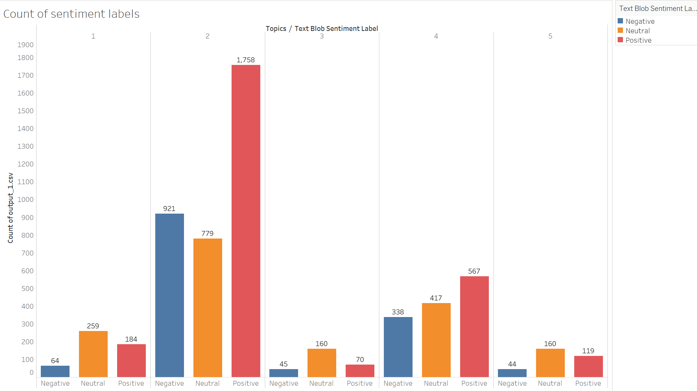
Sentiment analysis on topics
Topic 1 – Time, personal, and finance expressions
Topic 2 – Order and Delivery Process
Topic 3 – Customer and Driver Interactions
Topic 4 – App Support and Assistance
Topic 5 – Technical issues with online platforms and services
Based on the graph, we observe that Topic2 [Order and Delivery Process] has high positive, negative and neutral sentiment scores compared to other topics.
This suggests that users have strong feelings and opinions about this aspect of Order and delivery process. This could be due to a variety of reasons, such as experiences with late deliveries, incorrect orders, or smooth and easy delivery experiences.
As such, it may be important for food delivery apps to pay close attention to the order and delivery process and strive to ensure that it is as seamless and error-free as possible in order to maintain high levels of user satisfaction and minimize negative sentiment.
.
Notes:
Based on the graph, it appears that users have a generally positive sentiment towards topics related to time, personal, and finance expressions (Topic 1) and the order and delivery process (Topic 2). However, the negative sentiment score for Topic 3, which is related to customer and driver interactions, is the highest among all topics, suggesting that there may be room for improvement in this area. Meanwhile, the negative sentiment score for Topic 5, which is related to technical issues with online platforms and services, is also a cause for concern.
To draw a conclusion, food delivery apps in the USA should focus on maintaining the strengths of Topic 1 and Topic 2, which have high positive sentiment scores, while also addressing the weaknesses of Topic 3 and Topic 5. Improving customer and driver interactions and minimizing technical issues could help to improve the overall user experience and increase positive sentiment towards food delivery apps.

Slide 28
LESSONS LEARNED
Data Collection : Collecting data from relevant sources, such as Subreddit threads, can provide valuable insights into the market and customer behavior.
Preprocessing: Preprocessing the data by removing stop words, stemming, and lemmatizing the text can help in reducing the noise in the data, and make it easier to identify the relevant topics.
Choosing the right algorithm: There are several algorithms available for topic modeling, such as LDA and Non-negative Matrix Factorization (NMF). Choosing the right algorithm can help in generating accurate and meaningful topics.
Identifying the number of topics: Identifying the optimal number of topics is essential to avoid overfitting or underfitting. The number of topics can be determined using techniques such as coherence score and perplexity score.
Interpretation: Interpreting the topics generated by the algorithm is crucial to derive meaningful insights. Analyzing the top words in each topic and the context in which they are used can help in understanding the underlying themes and sentiments.
Application: The insights gained from topic modeling can be applied to various aspects of market research, such as product development, marketing, and customer engagement strategies. The insights can also be used to inform business decisions, such as market entry strategies and competitive analysis.
Notes:
Here are some lessons learned from topic modeling while collecting data of DoorDash, Grubhub, and Uber Eats from Subreddit for understanding Zomato's market entry in the USA:
Data collection: The quality and quantity of data collected is critical to the success of topic modeling. Collecting data from relevant sources, such as Subreddit threads, can provide valuable insights into the market and customer behavior.
Preprocessing: Preprocessing the data by removing stop words, stemming, and lemmatizing the text can help in reducing the noise in the data, and make it easier to identify the relevant topics.
Choosing the right algorithm: There are several algorithms available for topic modeling, such as LDA and Non-negative Matrix Factorization (NMF). Choosing the right algorithm can help in generating accurate and meaningful topics.
Identifying the number of topics: Identifying the optimal number of topics is essential to avoid overfitting or underfitting. The number of topics can be determined using techniques such as coherence score and perplexity score.
Interpretation: Interpreting the topics generated by the algorithm is crucial to derive meaningful insights. Analyzing the top words in each topic and the context in which they are used can help in understanding the underlying themes and sentiments.
Application: The insights gained from topic modeling can be applied to various aspects of market research, such as product development, marketing, and customer engagement strategies. The insights can also be used to inform business decisions, such as market entry strategies and competitive analysis.

Slide 29
Going forward
EXPLORATION OF DIFFERENT ALGORITHMS
Explore topic modeling using algorithms other than LDA and compare results.
ADDITIONAL ANALYSIS
Perform Sentiment analysis on each of the Topics discovered to further explore customer experience.
EXPANSION OF DATA SOURCE
Collect data from other social media other than Reddit, such as Twitter, Instagram, Facebook, as each medium may have different characteristics.
APPLICATION
Keeping in mind streamlining of the ordering and delivery process, positive customer interactions with drivers and appropriate grievance redressals when launching in the US will help Zomato become a profitable venture.
Notes:
With these learnings in mind, if we were to carryout this project in the future, these are some points that might help us improve our analysis.
First, for this project we only used the LDA model, however we could explore other options and compare the results to extract the insight best fit for the business.
Next, we could go further into sentiment analysis. Although we have conducted some elementary analysis, taking a deeper dive could help us identify not only what aspects of food delivery people are passionate about, but also if that passion comes from a negative or positive place. This could suggest places for improvement and strengthening.
Next, for this project we only used reddit data, but as each social media platform could have a different user demo or different characteristics (for example, instagram is more known for sharing flaunt-worthy pictures while twitter is for short rants), expanding the data source would also provide new insight.
Lastly, application of the model and learnings is the purpose of this project, so looking for ways to continue improve the business is somethings we should always keep in mind

